Slide 1
MontE Carlo Methods
Eric Prebys
Phy 40
Fall 2025

Slide 2

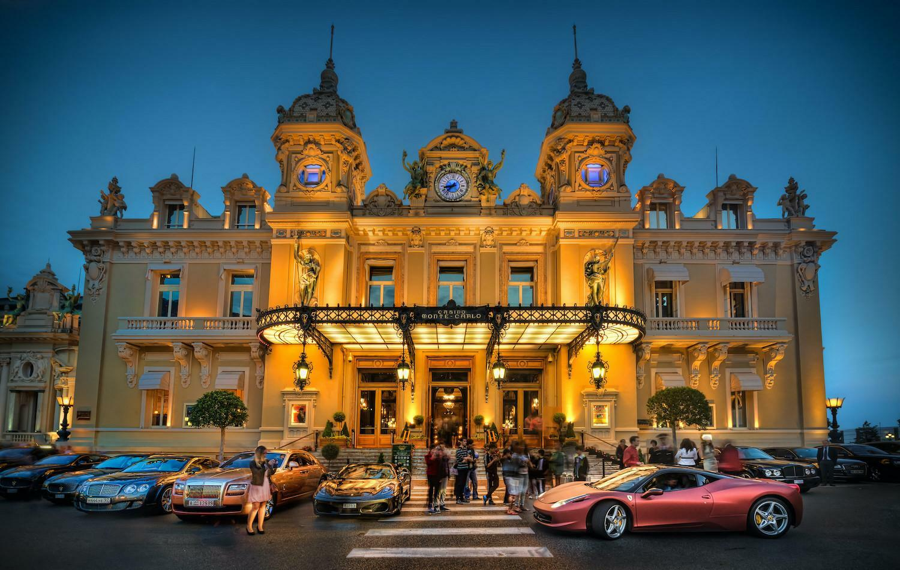
Monte Carlo Methods
“Monte Carlo” is a generic term for a statistical analysis based on random distributions.
Named for Monte Carlo, Monaco, famous for
gambling
Monte Carlo methods are used in a huge range of scientific applications in all sorts applications
Detector performance
Medical treatments
Particle accelerator modeling
Material science
Climate science
Etc, etc
In modern experiments, the physics analysis can be viewed as a part of the the Monte Carlo analysis, rather than vice versa.

Slide 3
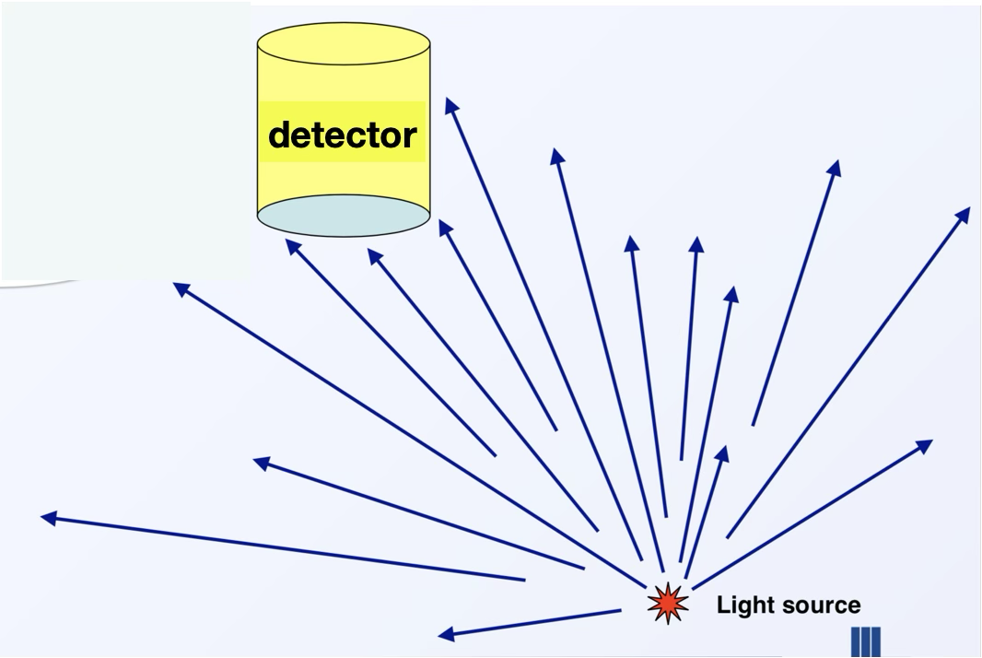
Example: Detector Acceptance
How many particles from a particular source will hit a detector

Slide 4
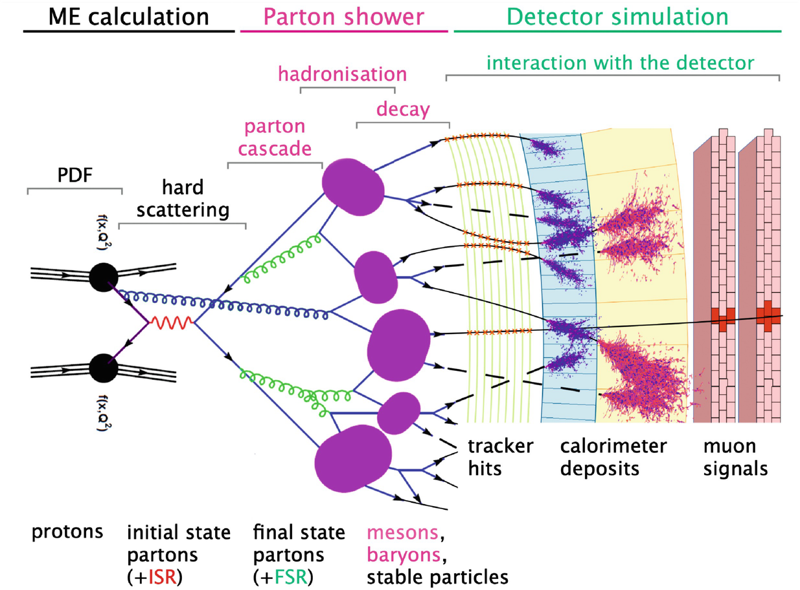
Complicated Example: Full Event Simulation at CERN

Slide 5
Markov Chain
Most of our Monte Carlo examples involve what is called a “Markov Chain”
A Markov Chain is a stochastic process in which each subsequent state depends only on the previous state.
Sometimes referred to as “memorylessness”.
Some non-Markov chains can become Markov chains with more information
For examples, if I’m playing Black Jack, the probability of the cards coming up in each deal are non-Markov to the players.
However, the process becomes Markov if I include the cards remaining in the deck after each deal.

Slide 6
Simple Example: Calculating π with Monte Carlo
We’re going to throw a set of points to uniformly populate a square of sides 2r.
We expect the fraction of the points that fall inside of an inscribed circle of radius r to be the ratio of the areas
Let’s call them “hits”
You’re going to do a variation of this in lab, so I’ll stop here.

Slide 7
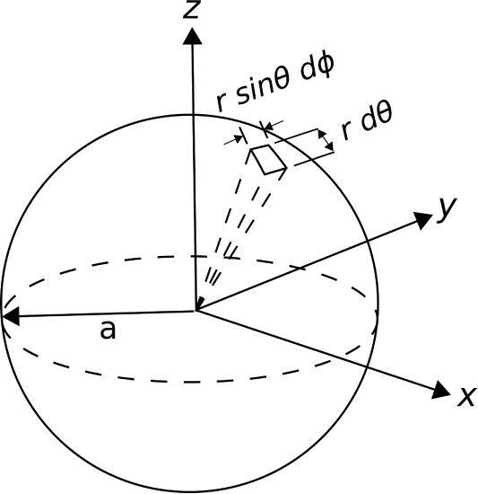
Spherical Distributions
If we look at the differential surfaces area of a sphere
A distribution that’s uniform in φ and (cosθ) will be spherically symmetric
Solid angle

Slide 8
Detector Acceptance Example
If we generate a spherically symmetric distribution of particles, how many will it a target of 50 cm radius 5 m away?
We expect the fraction to be the ratio of the areas

Slide 9
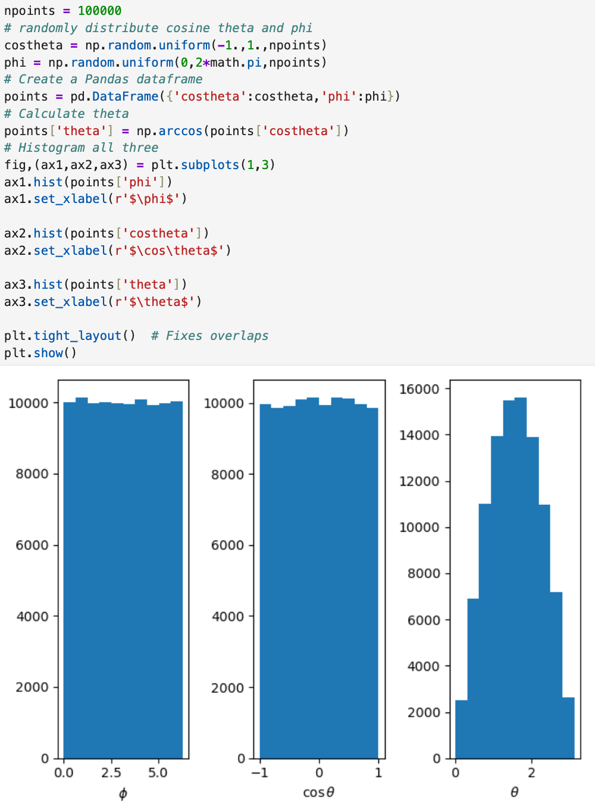
Code Example
Calculate θ from cosθ
Does this make sense?

Slide 10
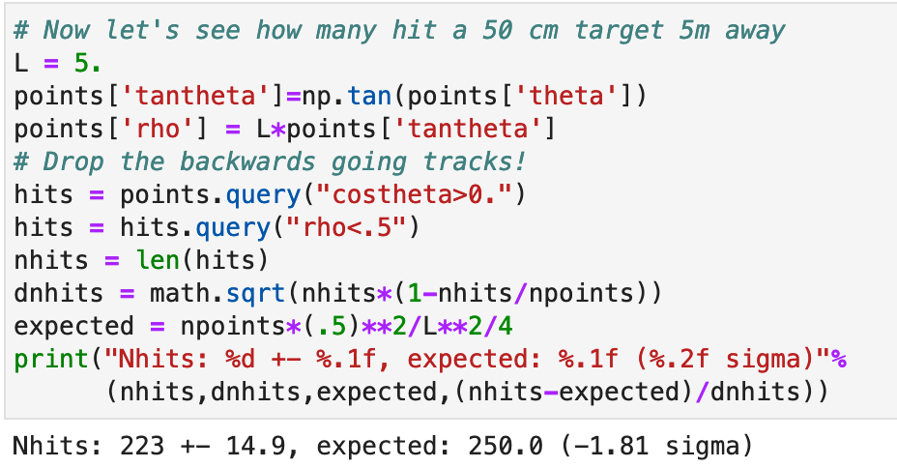
Project to Target
Calculate tanθ
Calculate radius at target
Drop backward going tracks!
How many are ρ<50 cm?
Compare to expectations.

Slide 11
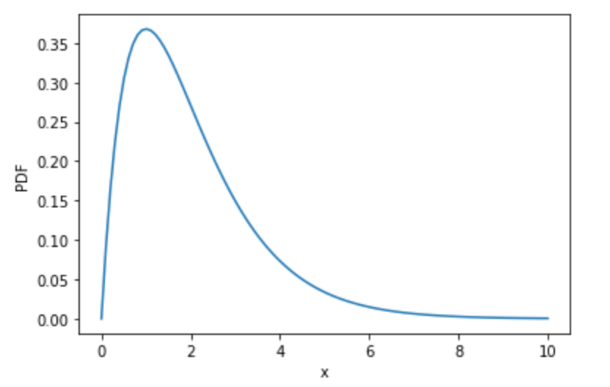
Reminder: Arbitrary Distributions
max
Example:
Step 0: Choose a range for your random numbers
Step 1: Generate a random value of x which is uniformly distributed over the range.
Step 2: Evaluate the PDF at this point
Step 3: Is the PDF value at this point greater than a random number between 0 and that maximum value of the function?
Yes? Return the value of x
No? Go back to step 1
range

Slide 12
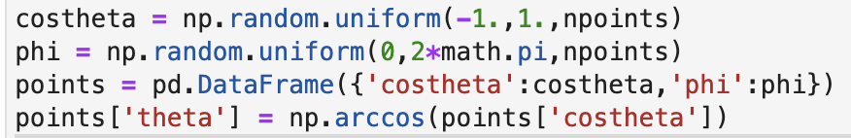
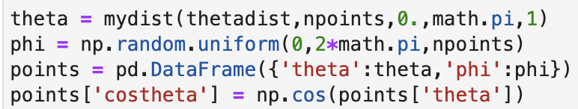
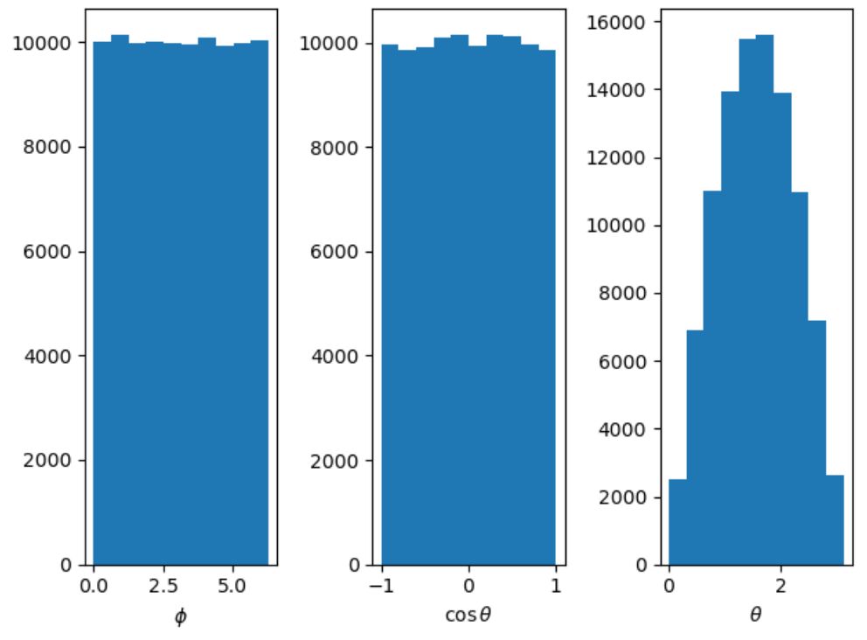
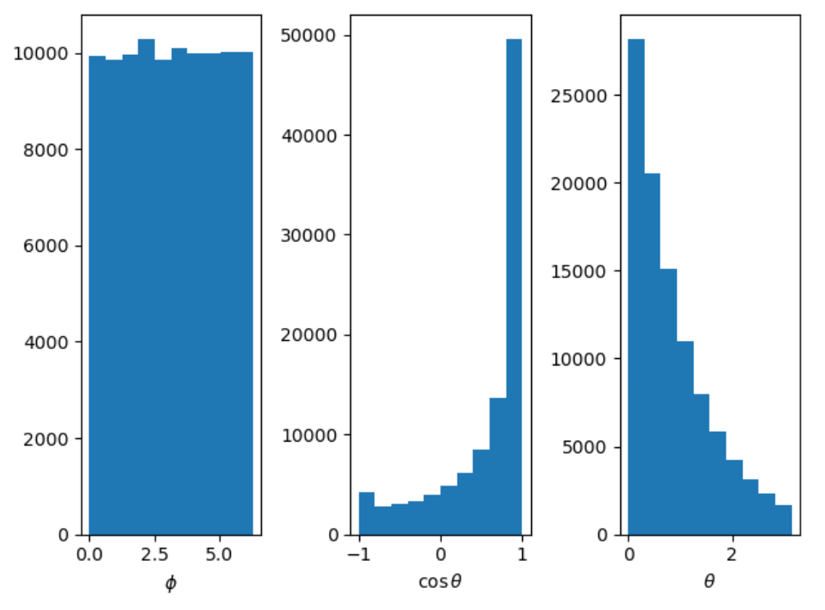
Arbitrary Angular Distribution
Instead of uniform cos(θ), try

Slide 13
GEometry ANd Tracking (GEANT)
There are many Monte Carlo tools for different applications, but by far the most widely used is GEANT.
GEANT is a system of simulation and visualization tools, developed at CERN for particle physics.
The first version of GEANT was written in FORTRAN in 1974.
The capabilities of GEANT were greatly expanded in GEANT3 (still in FORTRAN) from 1982 through the early 1990s to support the experiments at the LEP collider at CERN.
Beginning in the 1990s, GEANT4 was entirely re-written in object-oriented C++.
It has since branched out from HEP to become a ubiquitous simulation tool in many fields
A host of specialized physics libraries has been developed to support the different user communities.

Slide 14
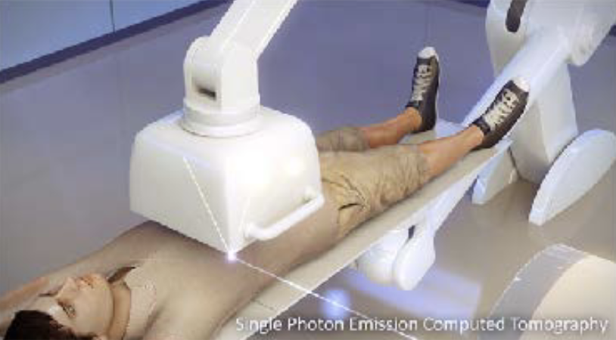
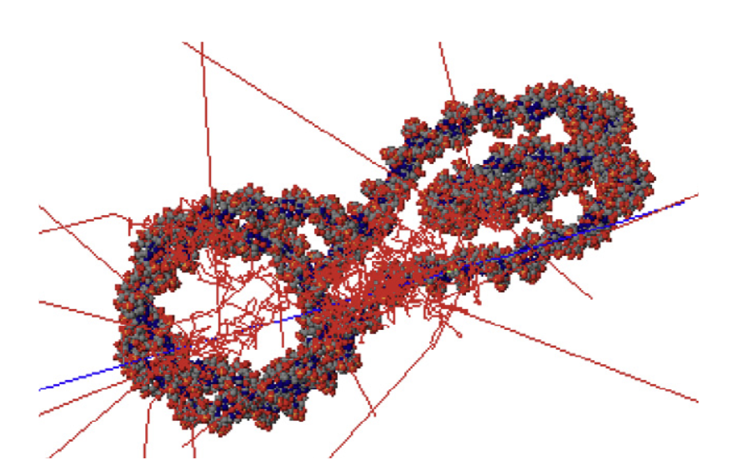
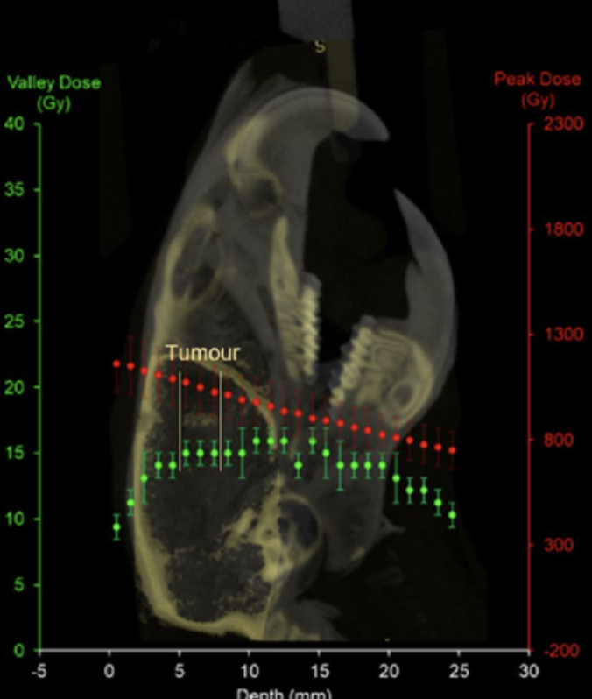
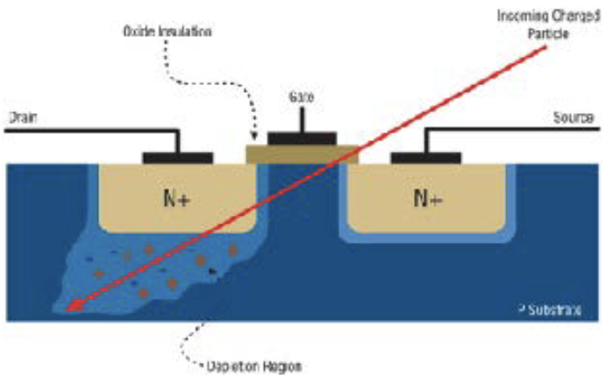
Other Users of Geant4 Include
Nuclear physics
Hadron therapy
Radiobiology
Positron Emission Tomography (PET)
Spacecraft shielding
Radiation damage
Single event effects (SEE) in electronics
Neutron spallation targets
ALL types of detector development
Many others

Slide 15
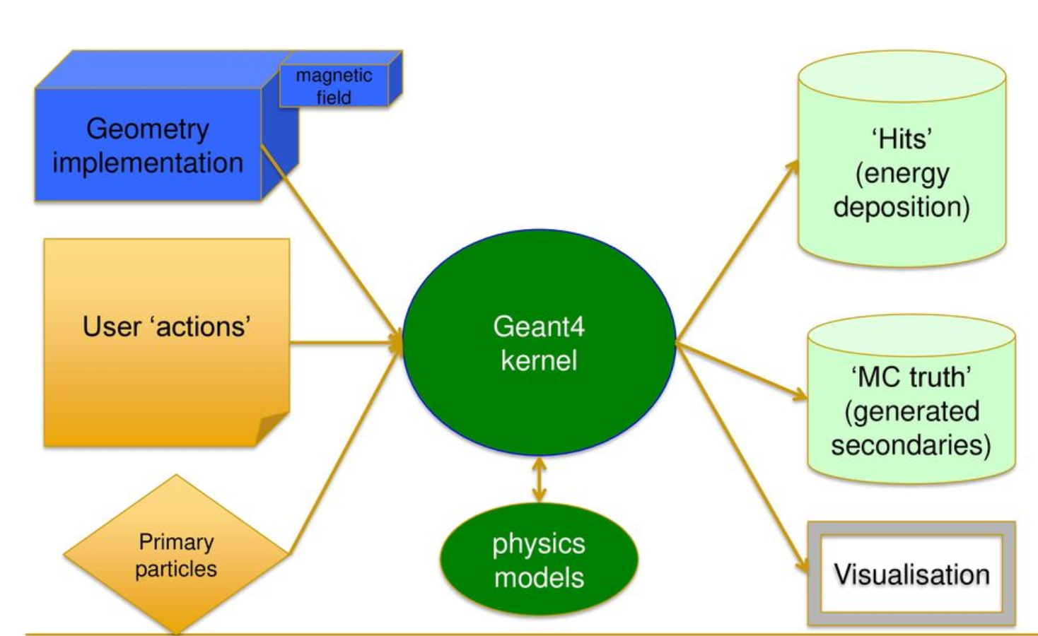
General Structure of Geant4
Handles for user customization at every level!

Slide 16
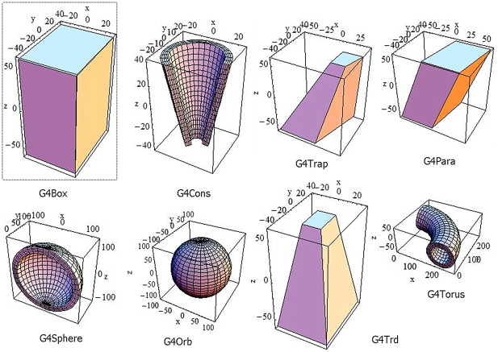
Geometry in Geant4
Geometry is built using a variety of “primitives”

Slide 17
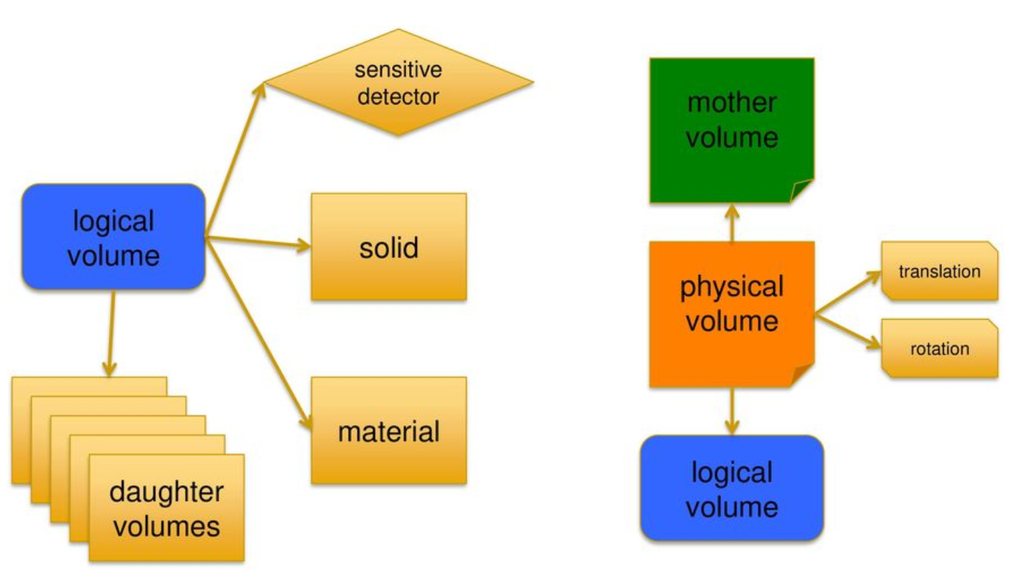
Geometry (cont’d)
Volumes can be translated, rotated, embedded, etc

Slide 18
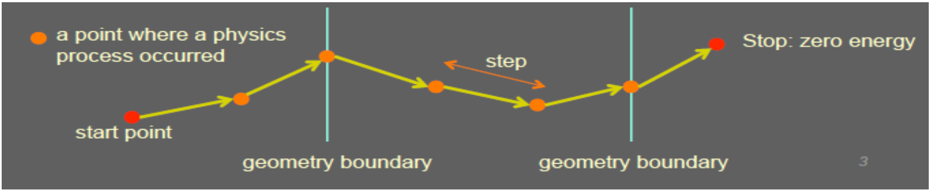
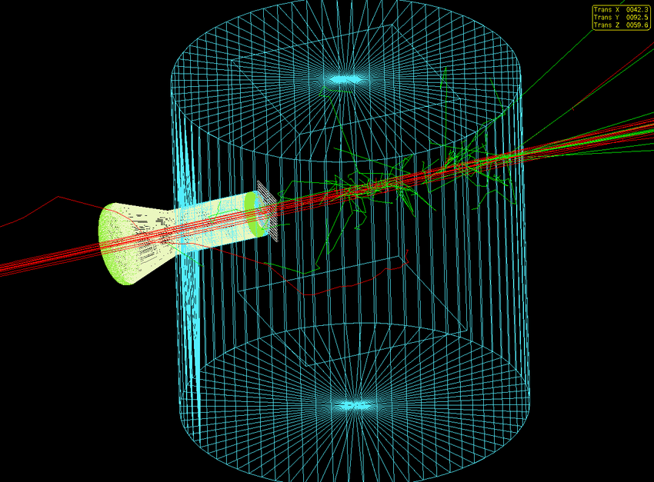
Tracking in Geant4
Particles are “stepped” through the material, depositing energy along the way
If it’s a sensitive volume the deposited energy is “scored”
Secondaries:
Secondaries can be created through decay or interaction
They are also tracked, down to a specified cutoff energy

Slide 19
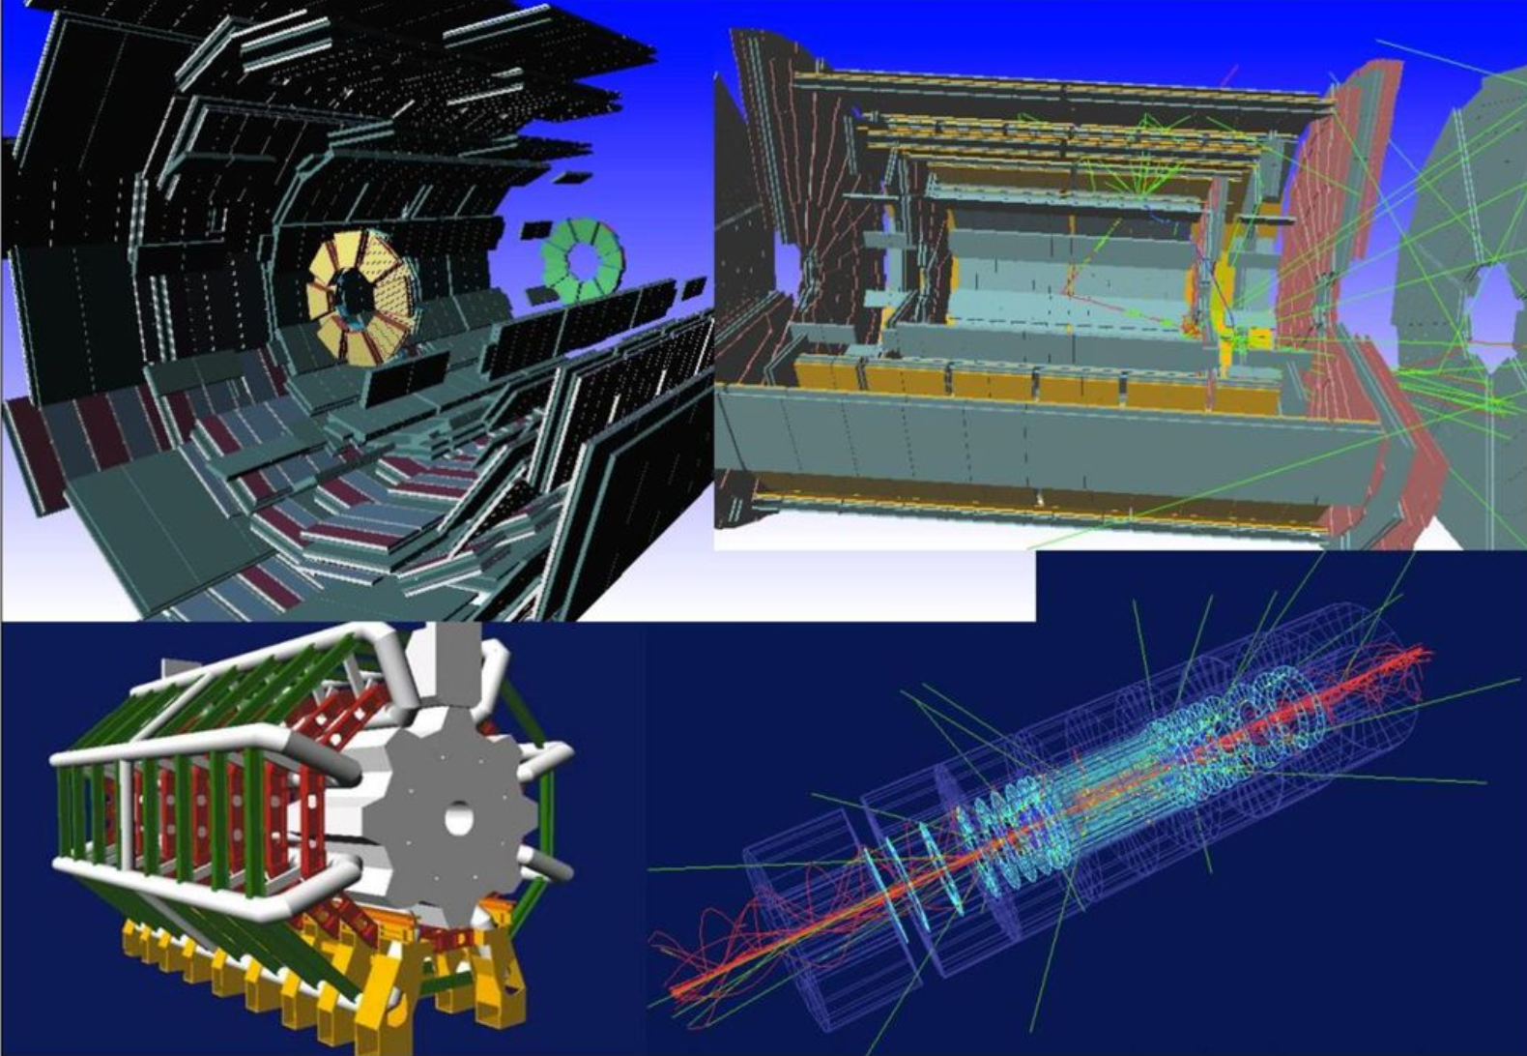
Example: ATLAS at LHC
Done with full Geant4

Slide 20
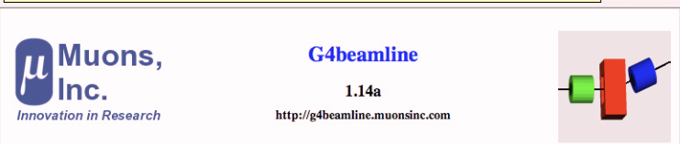


Geant4 is Horrible!
Geant4 is kind of a nightmare to use.
Even the simplest programs are quite complex to set up.
For this reason, numerous scripted/GUI “wrapper” programs had been written to ease the pain of using it. Examples:
g4beamline: beamline (sort of) and detector modeling
BDsim: accelerator modeling
TOPAS: medical physics

Slide 21
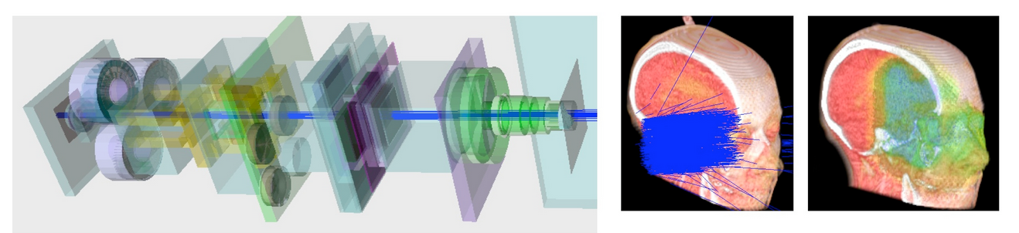
Example: Proton Therapy
Implemented in TOPAS

Slide 22
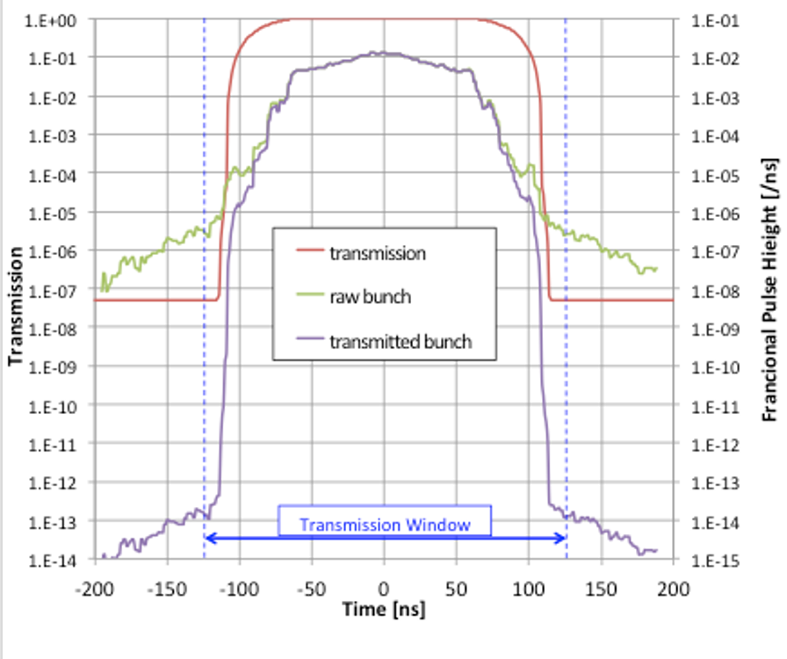
Example: Mu2e Beamline
Implemented with g4beamline
Used to model “extinction” of out-of-time beam

Slide 23
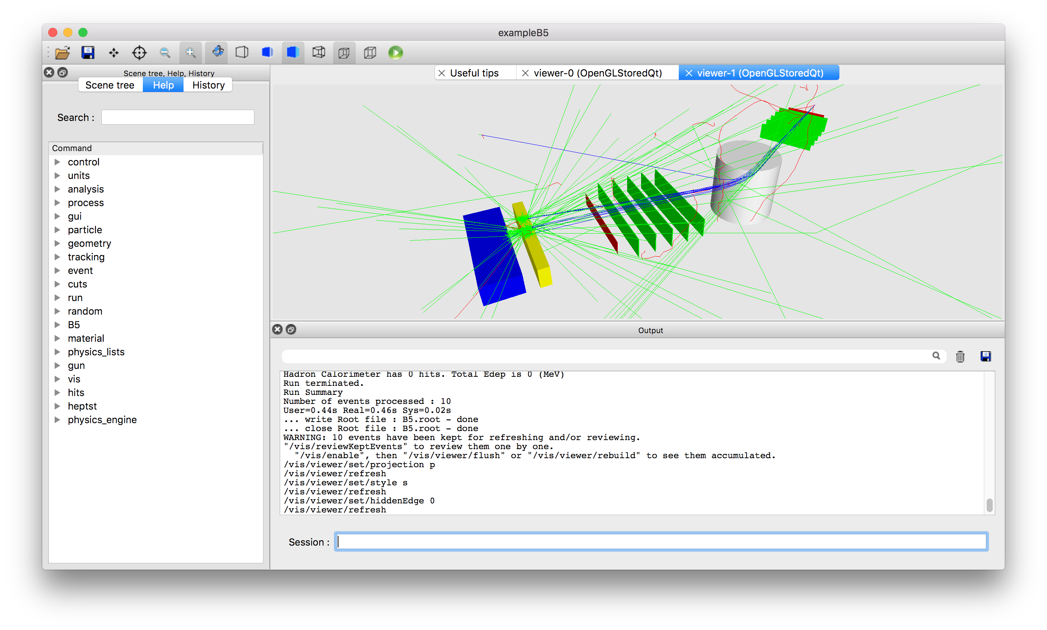
Example: Particle Scattering with BDsim

Slide 24
Types of Monte Carlo Studies
There are a range of Monte Carlo studies, going from…
“Fast” or “Toy”
Underlying physical processes are simulated
Detected and/or reconstructed data are dropped, misclassified, or “smeared” according to measured or anticipated acceptance, confusion matrices, and resolution.
”Full” or “hits based”
Physical processes are simulated.
These are used to generate the lowest level signals in the detector
Tracker hits
Calorimeter signals
Cherenkov light
Etc
Noise hits are added if appropriate
These are then reconstructed an analyzed in exactly the same way as the real data.
The only difference is that you know the “true” answer
Fast Monte Carlo methods are appropriate for conceptual analyses, but full Monte Carlo studies are required for the release of any physics results.

Slide 25
Computing Requirements
A single Monte Carlo event requires more computing time than a real event
The hits take the same amount of time to reconstruct and analyze, but you have to add the time it takes to create them.
There will always be systematic uncertainties on the physics of simulations, but we would prefer that Monte Carlo statistics to not add significantly to our overall uncertainty
We need at least as many Monte Carlo events as real events
Preferably more
Monte Carlo production is a major part of any physics analysis

Slide 26
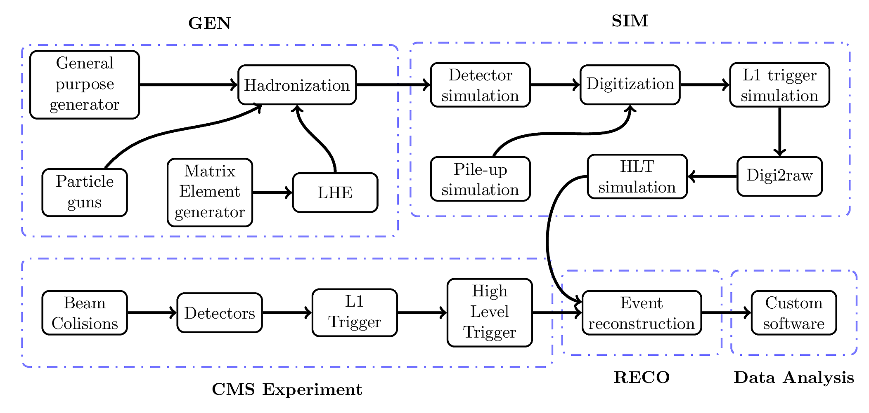
Example: CMS Monte Carlo Overview

Slide 27
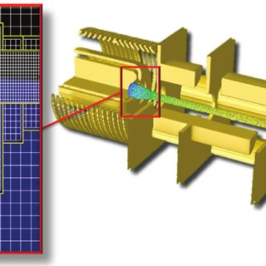
Other Monte Carlo Tools: Accelerator Physics
Historically, accelerator modeling tools are calculational rather than Monte Carlo
MADX
TRANSPORT
Treated particles within bunches are independent of one another
Did not consider interaction with environment (beam pipe, magnets, etc)
Modern improvements fall into two categories
Interactions with the environment
MARS or Geant4-based
Interactions with each other (i.e. “space charge”. VERY compute-intensive)
WARP
OPAL
Synergia
BLoND
edt

Slide 28

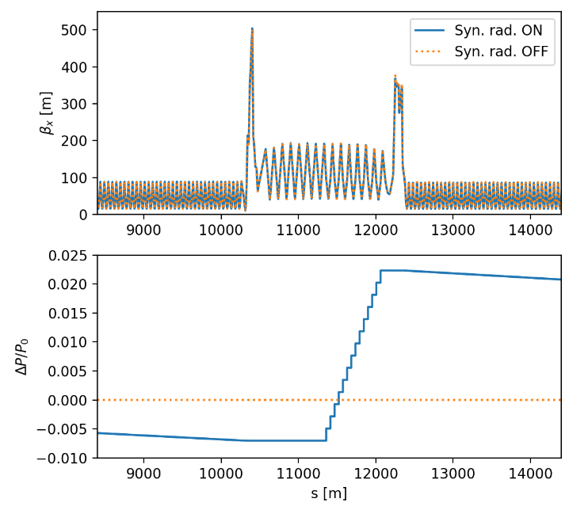
XSuite
XSuite is a new set of packages for accelerator modeling
Has now become the standard tool for LHC modeling at CERN.
User interface is Python based.
Xsuite is now part of the standard Python distribution.
Install with “pip install xsuite”

Slide 29
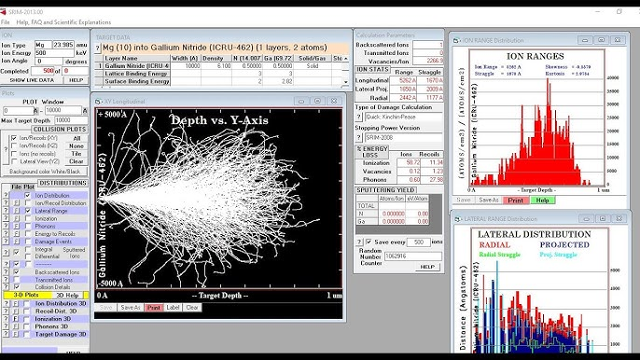
Radiation Effects
Stopping Range of Ions in Matter (SRIM) is the industry standard

Slide 30
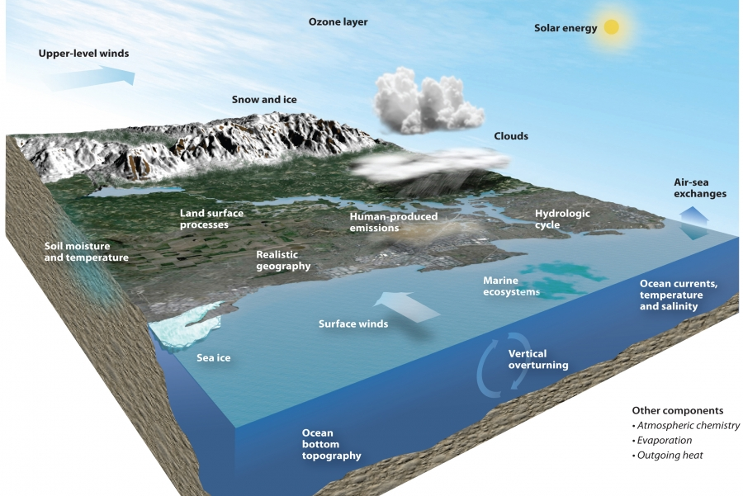
Climate Science
CESM (Community Earth System Model): CESM is a fully-coupled climate model | developed by the National Center for Atmospheric Research (NCAR). It includes components for the atmosphere, ocean, land surface, and sea ice. CESM supports Monte Carlo simulations for uncertainty analysis in climate projections.
CLM (Community Land Model): CLM is a widely used land surface model developed by the National Center for Atmospheric Research (NCAR). It's often coupled with atmospheric models and supports Monte Carlo simulations for uncertainty analysis.
WRF (Weather Research and Forecasting Model): WRF is a widely used mesoscale numerical weather prediction system. It has capabilities for conducting Monte Carlo simulations to assess uncertainty in weather forecasts and climate projections.

Slide 31
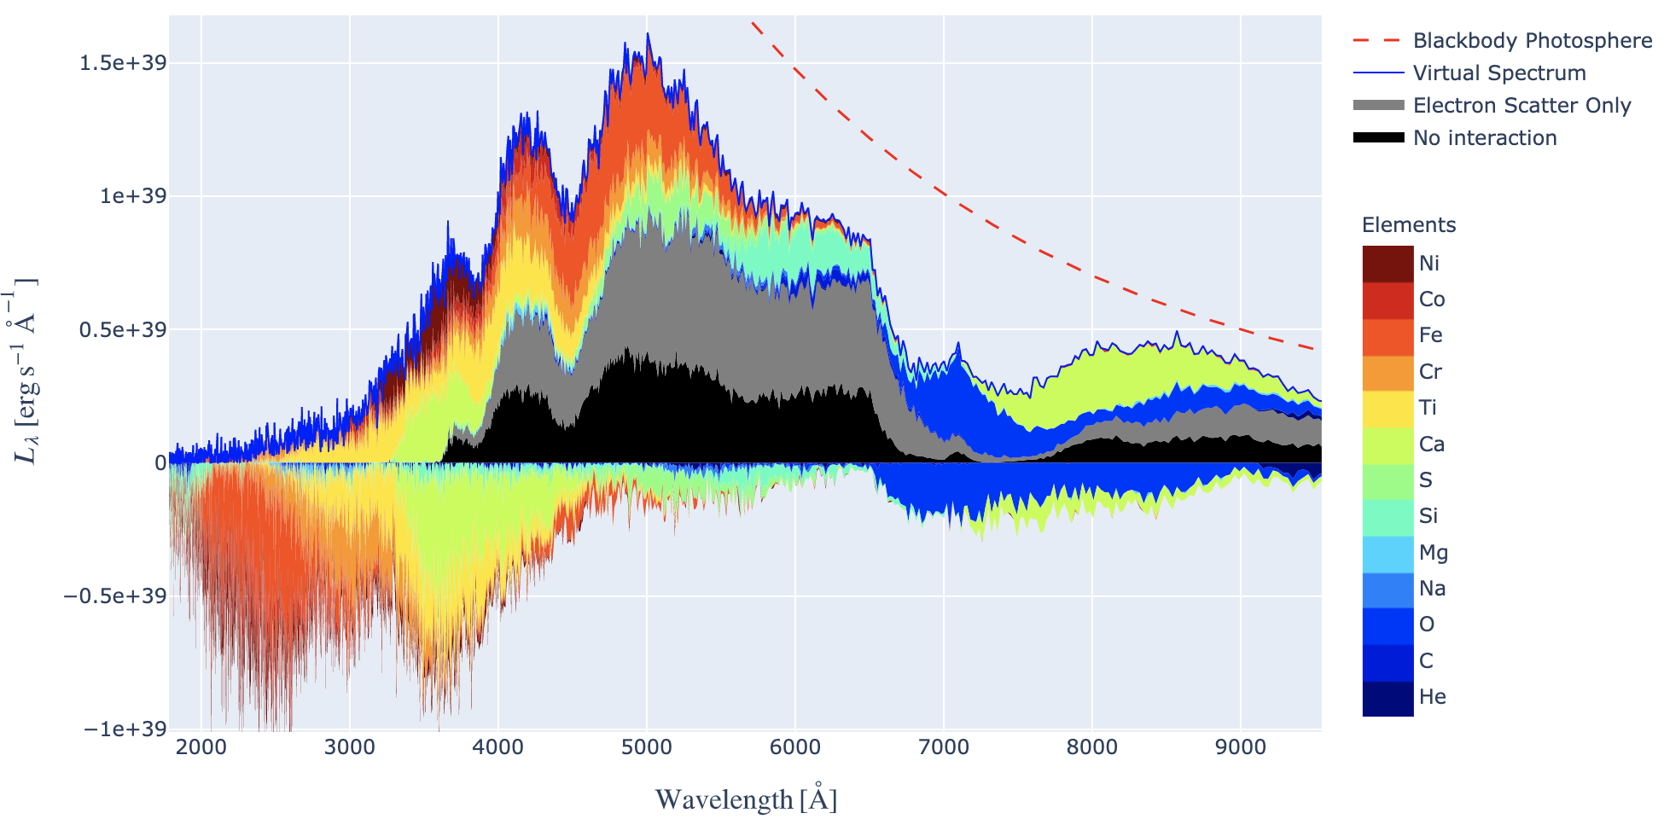
Supernova Simulations
Several, including TARDIS

Slide 32
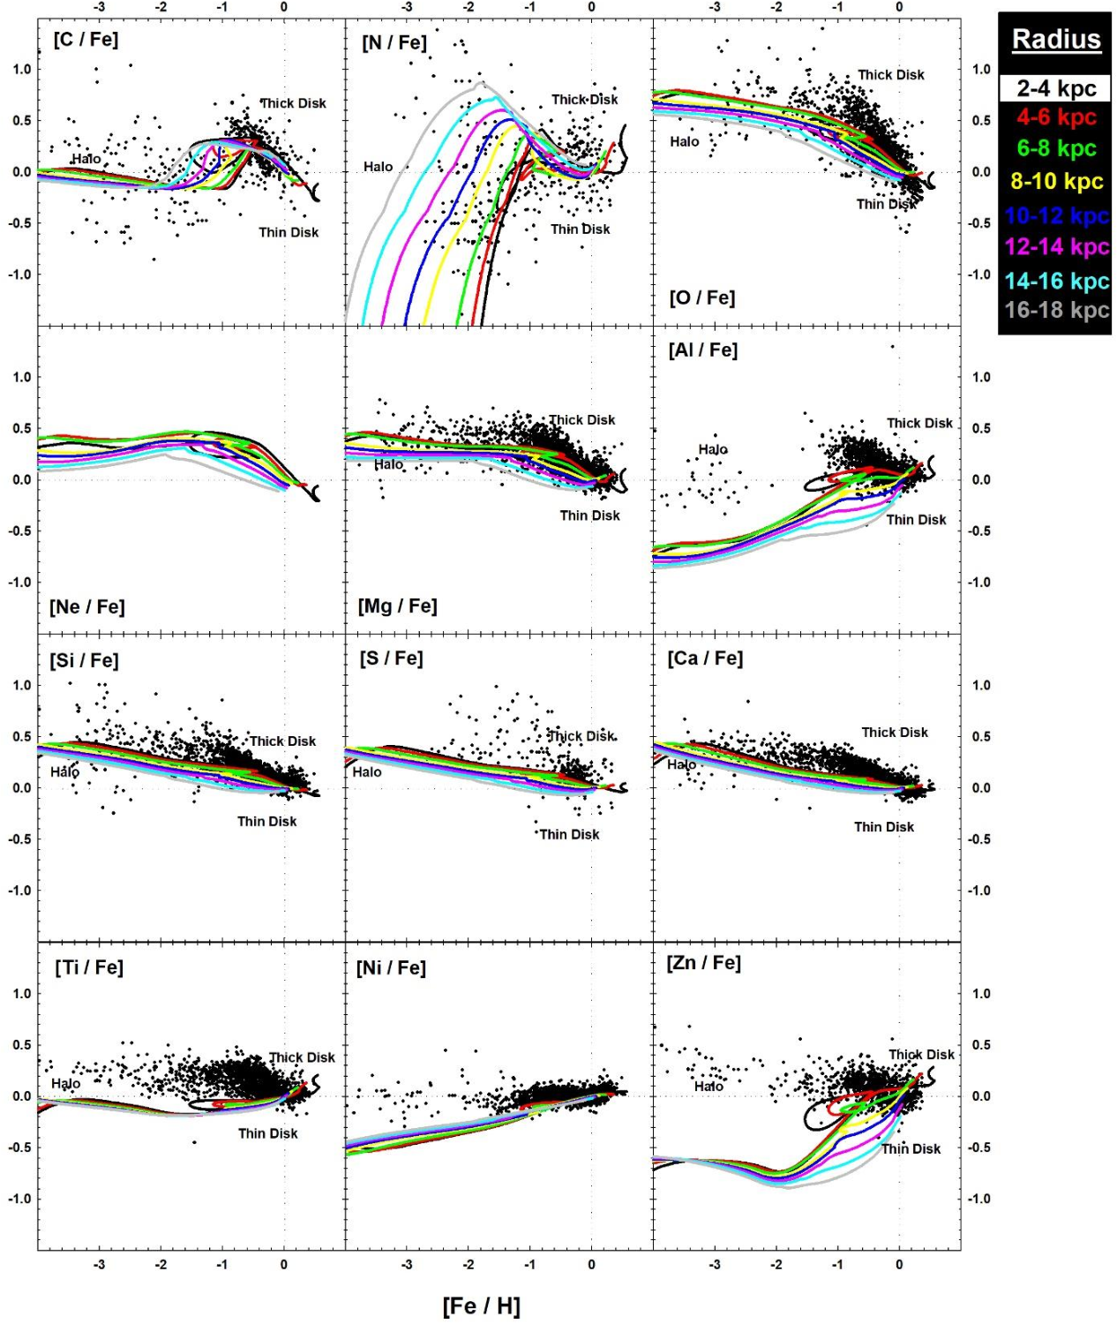
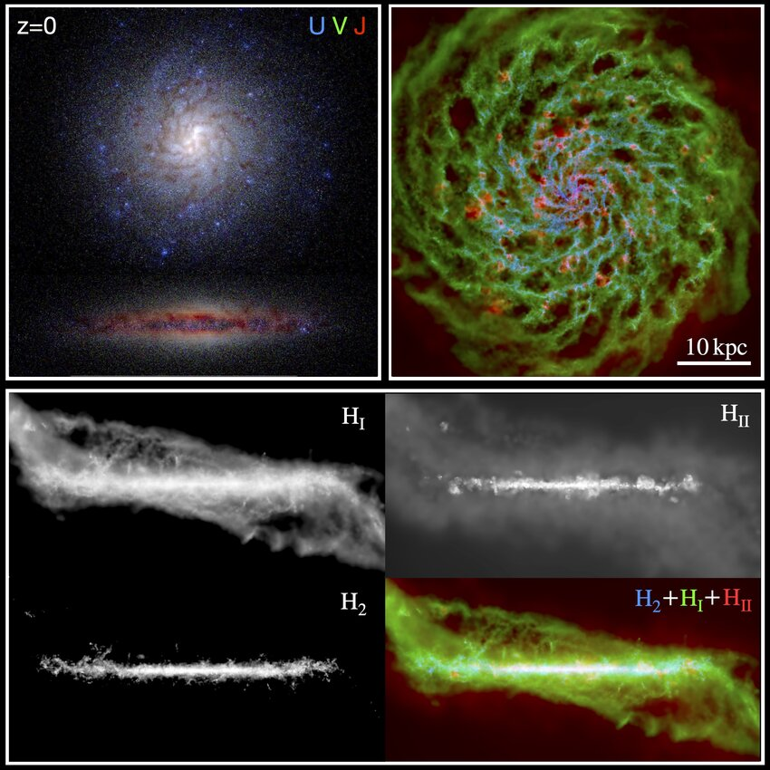
Galaxy Formation
MANY, incuding
GALFORM
GADGET
RAMSES
MUGS
Meraxes

Slide 33
Parallel Processing in Monte Carlo Studies (high level)
Because each event is independent, particle physics benefits from “high level parallelism”, both for analysis and simulation.
Each processing node handles one complete event at a time, and the results are transmitted to a host, which collects them.
This was well suited to the advent if inexpensive Unix processors, which were developed for the computer graphics and animation industry around 1990 (Silicon Graphics, HP, Sun, etc)
A few year later, Linux made “commodity computing” dirt cheap, and that’s how everything is done now.
Host
Linux Box
Linux Box
Linux Box
Linux Box

Slide 34
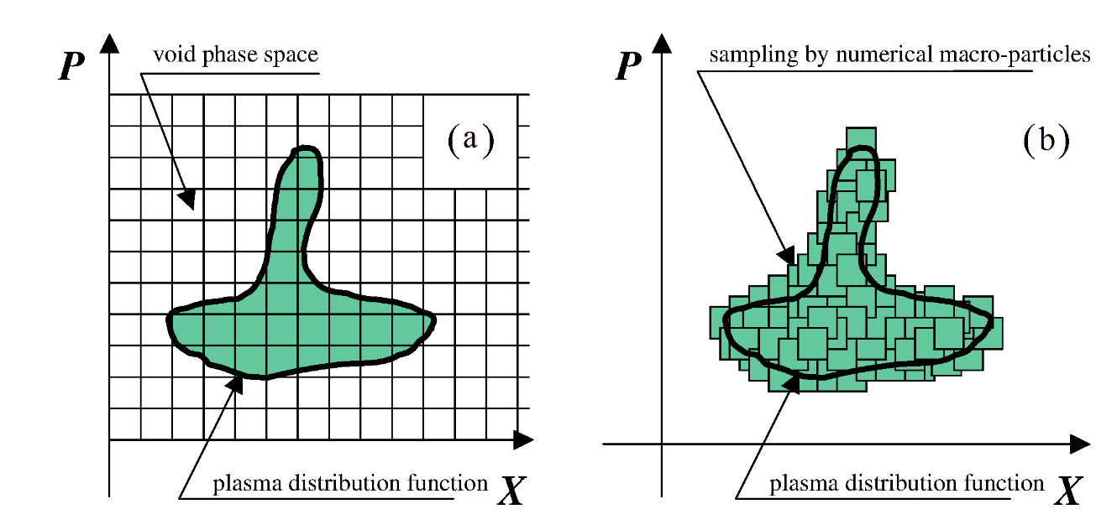
Low Level Parallel Processing
A number of challenging simulations (space charge, weather, hydrodynamics, galaxy formation, etc) involve the interaction of individual elements.
e.g. there are over 10¹¹ proton in each bunch in the LHC at CERN
Simulating the individual interactions would be beyond any conceivable computing power in the foreseeable future.
Monte Carlo techniques generally involve “Particle in Cell” (PIC) approaches, in which the aggregate is divided into “cells”, each containing many individual elements (particles, atoms, planets, etc)
The problem is now essentially solving a nonlinear differential equation
Which is also very hard!
Example: plasma simulation

Slide 35
Parallel Processing Applied to PIC
Generally each processor is assigned a cell or cells
The problem is that unlike the particle physics example, cells are far from independent. Information is exchanged among cells throughout the simulation process
The linux farm model would be completely useless.
Parallelism is achieved through a combination of
Multiple cores
shared memory
accelerating co-processors (GPUs, TPUs, etc)
This is a growth industry!

